Slide 1

SIH26025 | Distributed Edge Intelligence for Mine Subsidence Monitoring
AI-Assisted Real-Time Deformation Detection & Early Warning Decision-Support System
System Overview
Sensor Layer
Surface Sensor Nodes → Wireless Mesh → Pi 4 Edge Gateway → AI/ML Correlation Engine → GIS Dashboard + Alerts
ESP32-C3 nodes — tilt, vibration, displacement, crack state
Ministry of Coal / Coal India Limited
Hardware Category | Disaster Management Theme
Edge Intelligence
Objective: Continuous local deformation monitoring between conventional survey cycles
Raspberry Pi 4B — offline-capable AI/ML correlation engine
Output
GIS deformation map, risk zones, SMS/email alerts
Precise framing: This system is an AI-assisted deformation detection and early-warning decision-support tool — not a DGMS-certified structural-safety instrument and not a guaranteed cave-in predictor.

Slide 2
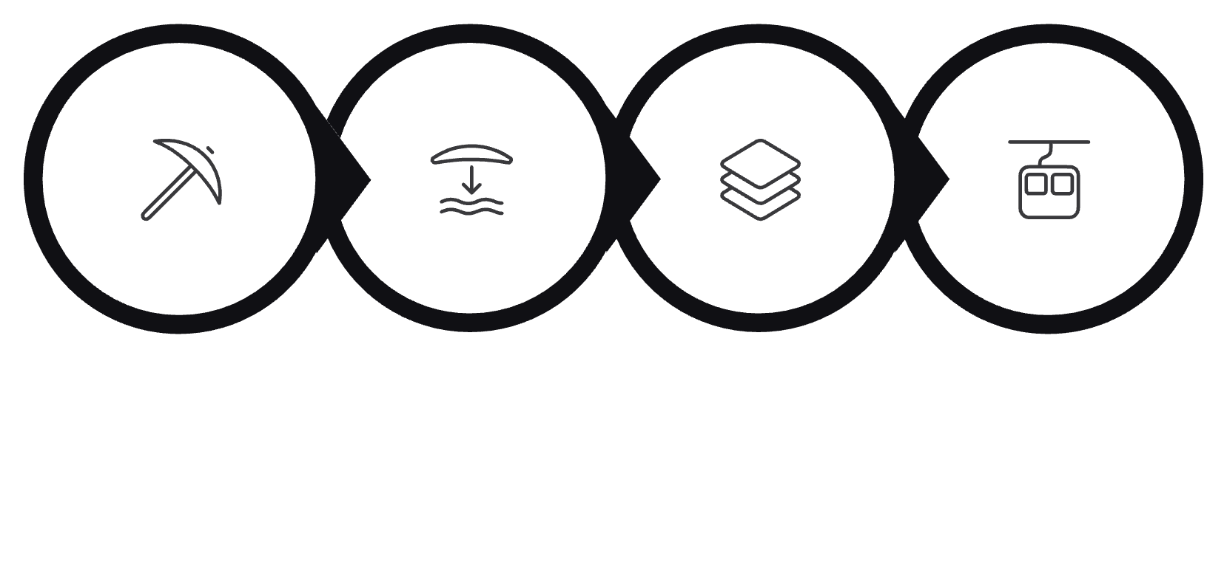


Problem → Engineering Requirements
Physical Phenomenon Chain
Derived Engineering Requirements
Continuous Monitoring
Multi-Point Deformation
Distributed sensor nodes — not periodic survey points
Wireless surface mesh — spatial correlation across nodes
Local Intelligence
No Reliable Internet
Extraction
Stress Shift
Ground Deform
Surface Tilt
Raspberry Pi edge gateway — inference without cloud dependency
Offline-first architecture — buffer, process, sync on reconnect
False-Positive Reduction
Low Deployment Cost
Multi-node spatial correlation — not single-threshold alerting
ESP32-based nodes — commodity hardware, modular expansion
Core constraint: The system must produce local intelligence and issue alerts even when cloud connectivity disappears entirely.

Slide 3
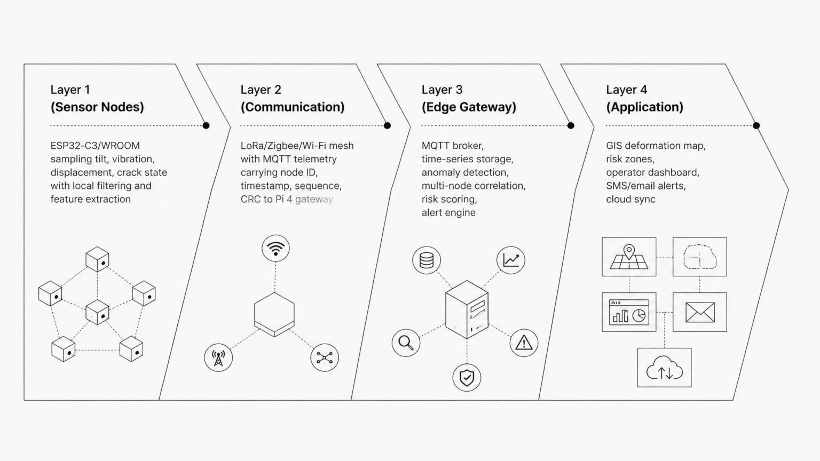
End-to-End System Architecture
Four-Layer Distributed Stack
Layer 1 — Sensor Nodes
Layer 2 — Mesh Comms
Layer 3 — Edge Gateway
Layer 4 — Application
ESP32-C3/WROOM. Local sampling at configurable intervals. On-node filtering and feature extraction before transmission.
LoRa / Zigbee / Wi-Fi mesh. MQTT telemetry with node ID, timestamp, sequence counter, CRC integrity check.
Pi 4 MQTT broker. Time-series DB. Anomaly detection, multi-node spatial correlation, risk scoring, alert dispatch.
GIS deformation map, risk zone overlay, operator dashboard, SMS/email alerts, optional cloud sync when online.
Key architectural principle: Intelligence is distributed across the mesh — not centralized in a cloud endpoint. The system degrades gracefully with each layer operating independently if upstream connectivity fails.

Slide 4

ULTRON Hardware → Mine Monitoring Platform
Existing Infrastructure Mapping
Prototype Boundary
Component | Role in System | Status
Raspberry Pi 4B 8GB | Edge gateway + AI/ML inference + MQTT broker | ✓ Real
Raspberry Pi 3A+ / 3B | Distributed sensor node controllers | ✓ Real
ESP32-C3 / ESP32-WROOM | Sensor interface, relay nodes, edge filtering | ✓ Real
5-Port Ethernet Switch | Local wired backbone for gateway cluster | ✓ Real
500GB SSD | Offline telemetry storage + on-device ML models | ✓ Real
NeoPixel + OLED Display | Visual status indicator + local alert display | ✓ Real
Physical Subsidence Transducers | MPU6050, ADXL345, displacement, crack sensors | Simulated
✓ Implemented & Real
⚙ Software-Simulated
Compute cluster, mesh network, MQTT broker, edge inference engine, correlation logic, GIS dashboard, alert pipeline, SSD storage
Physical subsidence transducers — replaced by sensor simulator publishing identical telemetry over the same MQTT interface
No new compute infrastructure required. Prototype runs entirely on existing ULTRON hardware inventory. Sensor simulator enables hardware-layer substitution without redesigning the downstream stack.

Slide 5


Sensor & Node Engineering
Physical Deformation → Digital Feature Vector
Node Processing Pipeline
Feature Vector Definition
X(t) = [tilt, vibration_RMS, displacement, crack_state, dX/dt]
Sample Data
Each node publishes a structured feature vector per sample epoch. The derivative term dX/dt encodes rate-of-change, enabling detection of accelerating deformation — the operationally significant condition — not merely absolute displacement magnitude.
Apply Filter
Prototype Sensor Status
Extract Features
Software Sensor Simulator
Physical transducers are currently replaced by a deterministic simulator that publishes the identical MQTT telemetry schema — same topics, same packet structure, same QoS levels. The downstream pipeline is sensor-hardware-agnostic by design.
Timestamp & Seq
Sensor Suite
Interface Compatibility
Future hardware sensor integration requires zero modifications to the edge gateway, correlation engine, or application layer. Only the node firmware changes at the physical interface boundary.
MPU6050
ADXL345
3-axis tilt / acceleration — primary deformation indicator
High-resolution vibration measurement — seismic event detection
Displacement Transducer
Crack Sensor
Absolute ground movement — vertical & horizontal components
Binary / analog crack-state detection at surface structures

Slide 6

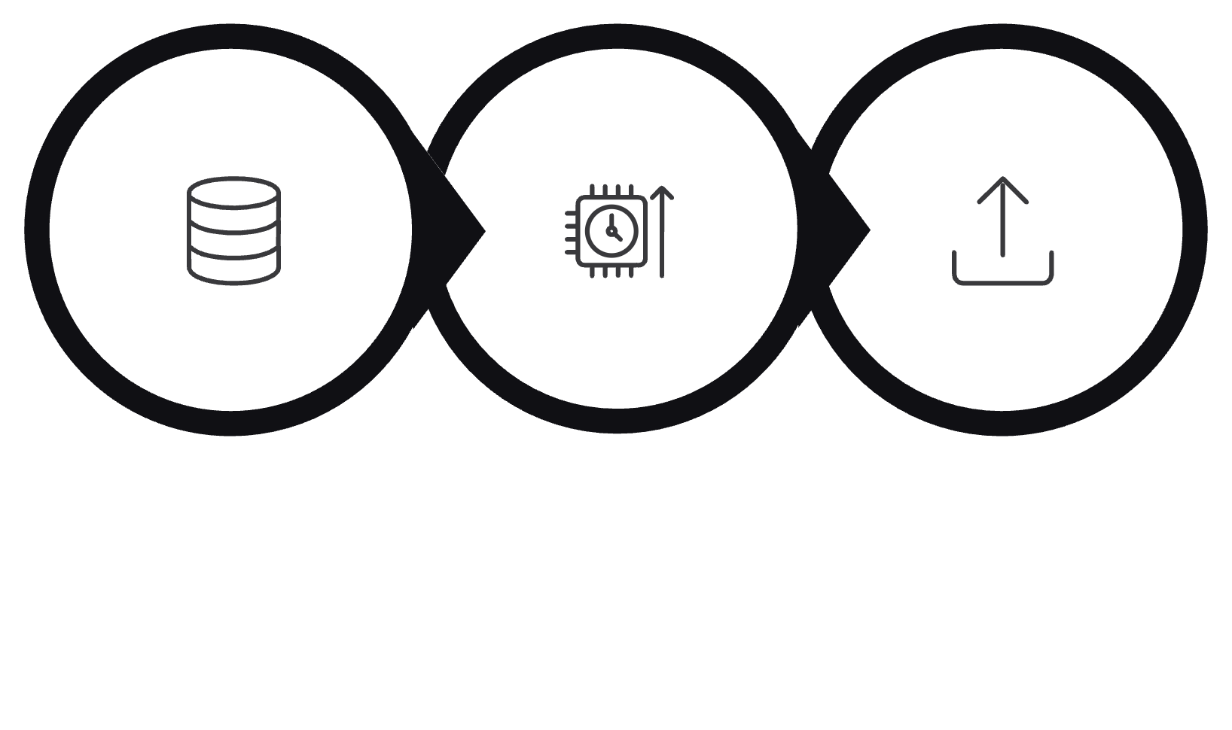
Distributed Telemetry Architecture
Multi-Node Data Pipeline
Mesh Topology & MQTT Topic Tree
Packet Structure
mine/node/{id}/data
mine/node/{id}/status
Field | Type | Purpose
node_id | String / UUID | Unique node identity for spatial correlation
timestamp | ISO 8601 UTC | Temporal alignment across mesh
sensor_type | Enum | Tilt / vibration / displacement / crack
value | Float | Calibrated engineering unit reading
unit | String | °, mm/s², mm, boolean
confidence | Float [0–1] | Node self-assessment of reading quality
sequence | Uint32 | Gap detection / replay ordering
CRC | Uint16 | Packet integrity verification
Routine sensor telemetry — all nodes, configurable publish interval
Node health, battery, signal quality, firmware version
mine/gateway/alert
mine/dashboard/update
Risk score threshold breach — triggers operator notification pipeline
GIS map refresh, risk zone overlay, operator dashboard payload
QoS Strategy
QoS 0 — At Most Once
QoS 1 — At Least Once
Offline Behavior
Routine telemetry — acceptable data loss on congestion
Critical alerts — guaranteed delivery with acknowledgement
Buffer Locally
Edge Inference
Reconnect & Replay

Slide 7
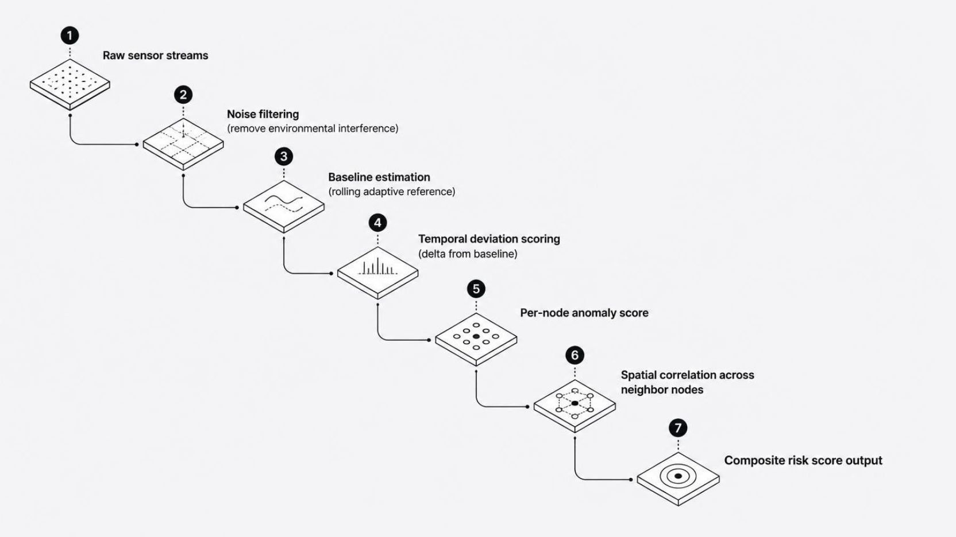

Anomaly Detection & Mesh Correlation Engine
Intelligence in Space + Time, Not Just Thresholds
Detection Pipeline
Correlation Decision Logic
Case A — Local Disturbance
Case B — Genuine Subsidence Indicator
High local anomaly score + low neighbor correlation → single-node event, likely environmental interference or mechanical vibration. Alert suppressed or downgraded.
Similar temporal deformation pattern across multiple neighbor nodes → spatially coherent ground movement. Risk score elevated. Operator alert dispatched.
Risk Scoring Function
Risk = f(temporal deviation, magnitude, persistence, neighbor correlation)
Score is a weighted composite — a single large spike that is brief and isolated contributes less than a moderate, persistent, spatially-correlated deformation trend. Operator thresholds are configurable per deployment zone.
Detection Methods
Statistical drift detection — CUSUM / EWMA on rolling baselines
Threshold-based alerting — configurable per sensor class
Lightweight ML anomaly detection — on-device inference, Pi 4 GPU-optional
Time-series feature analysis — trend, seasonality, rate-of-change decomposition

Slide 8





Fault Tolerance, Security & Offline Operation
Designed to Fail Gracefully
Failure Mode Response Matrix
Security Architecture
Failure Mode | System Response
Sensor failure | Mark node degraded; substitute neighbor-node readings for correlation
Node failure | Mark node offline; mesh routing continues around failed node
Network loss | Local buffering activated; edge inference and alerts continue uninterrupted
Gateway failure | Distributed node buffering; local NeoPixel/OLED alerts remain active
Time desync | NTP resync on reconnection; sequence numbers maintain ordering integrity
Node Identity
TLS MQTT
Unique hardware identity per node — prevents spoofed telemetry injection
Transport-layer encryption on all broker connections — no plaintext telemetry
Integrity Checks
Signed OTA
Sequence counters for gap detection; CRC16 on every packet for corruption detection
Firmware updates cryptographically signed — prevents unauthorized firmware deployment
Fail-closed principle: Inability to confirm a safe state generates operator attention — not silence. An unacknowledged alert is treated as a live alert.

Slide 9

Validation, Testing & Prototype Status
Six-Test Validation Framework
1
Stable Baseline
No deformation input — verify zero false alarms over extended observation window. Pass criterion: alert rate = 0 under quiescent conditions.
2
Single-Node Disturbance
Inject anomaly at one node — verify local detection without mesh-wide alert escalation. Validates correlation logic Case A.
3
Multi-Node Deformation
Simultaneous deformation across nodes A–D — verify spatial correlation triggers elevated risk score and operator alert. Validates Case B.
4
Injected Noise
High-amplitude random noise on sensor streams — verify filtering layer suppresses spurious signals before feature extraction.
5
Network Disconnect
Sever gateway connectivity — verify local buffering, continued edge inference, and correct replay on reconnection.
6
Node Failure
Power-off individual nodes — verify mesh routing adapts, degraded node is marked, and correlation continues on remaining nodes.
Physical Validation Approach
Case-Study Validation Approach
Scale-model ground rig with mechanically actuated deformation — simulated sensor streams injected at calibrated displacement magnitudes. Validates detection pipeline end-to-end.
Public subsidence event data and InSAR satellite deformation datasets used to verify that the correlation and risk-scoring engine would have flagged known events. No accuracy numbers fabricated — validation framework is the deliverable.
Prototype transparency: REAL — compute, network, MQTT, edge inference, correlation engine, GIS dashboard, alert pipeline, SSD storage. SIMULATED — physical subsidence transducers (identical telemetry interface to future hardware).

Slide 10



Deployment Roadmap & Technical Differentiation
Prototype → Pilot → Scale
vs. Conventional Mine Monitoring
Prototype — 3–4 Nodes
Dimension | Conventional | This System
Sampling | Periodic survey cycles | Continuous real-time
Coverage | Discrete survey points | Distributed mesh topology
Processing | Central / manual analysis | On-device edge inference
Connectivity | Requires network access | Offline-first, sync on reconnect
False Positives | Single-point thresholds | Multi-node spatial correlation
Alerting | Post-survey reporting | Local + remote, real-time
Scalability | Linear survey cost | Modular node addition
ESP32 + Wi-Fi/Ethernet in lab environment. Full stack validated on ULTRON hardware. Sensor simulator in place.
Pilot — 20–50 Nodes
LoRa/Zigbee mesh + ruggedized weatherproof enclosures deployed at mine site perimeter. Hardware transducers integrated.
Scale — 100–1000+ Nodes
Distributed gateway cluster, multi-site synchronization, hierarchical MQTT broker federation, centralized GIS aggregation.
Scope boundary: A distributed, edge-intelligent, offline-capable deformation monitoring layer operating between conventional survey cycles. Decision-support early indicator — not a DGMS-certified structural-safety instrument and not a guaranteed cave-in predictor.

